Slide 1
Special Council Meeting Agenda
Call To Order
Roll Call
Pledge of Allegiance
Discussion
Discussion Of Traffic Patterns On MacArthur Drive
Public Comments
Adjournment
Next Regular Meeting is September 10, 2024

Slide 2
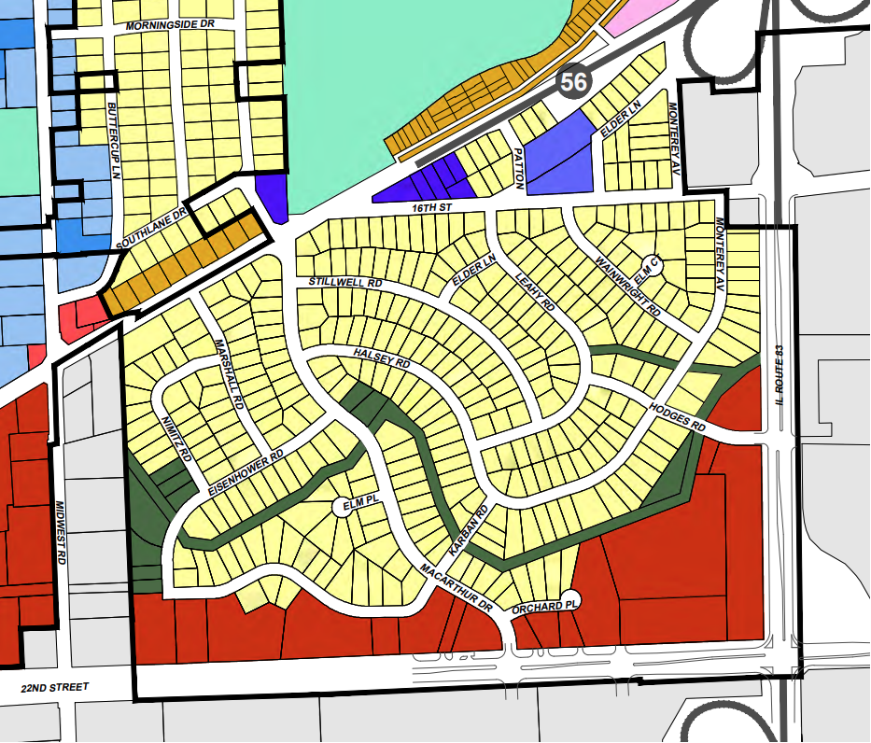
Oakbrook Terrace
Ward 1
Ward 2

Slide 3
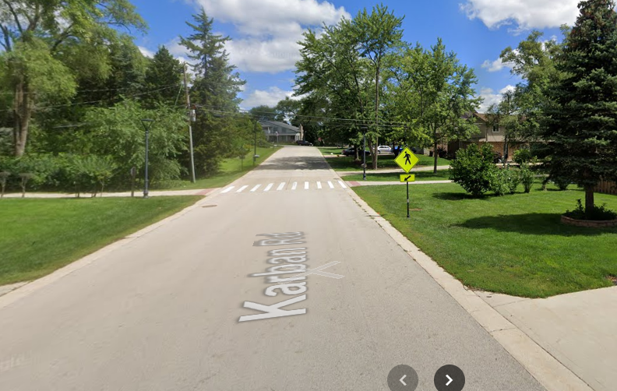
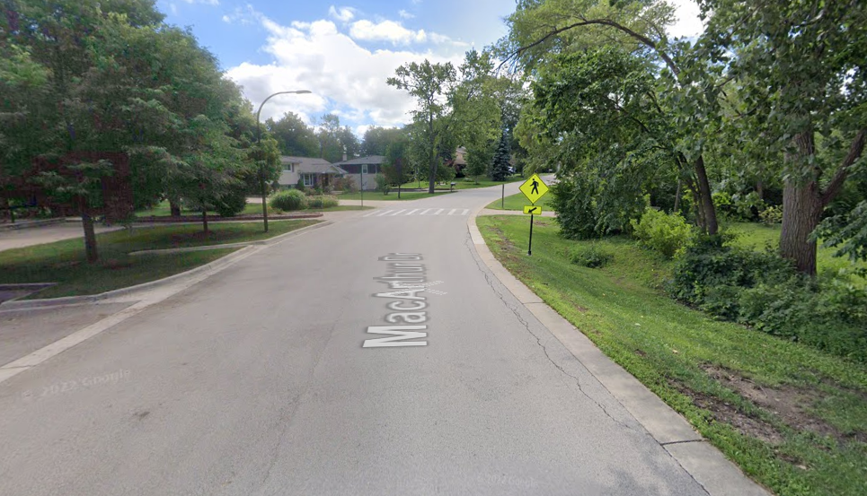
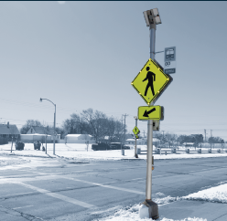
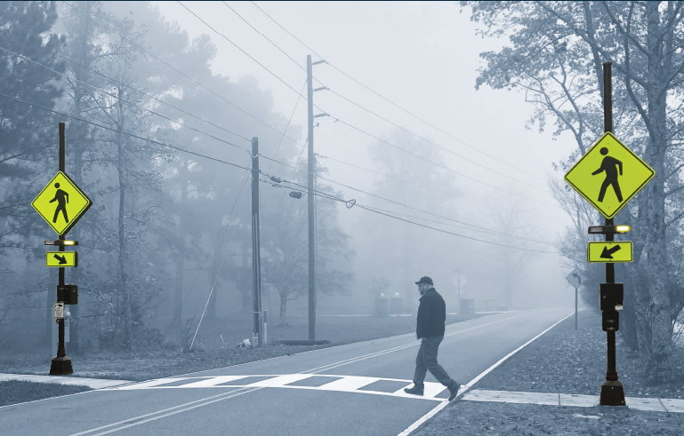
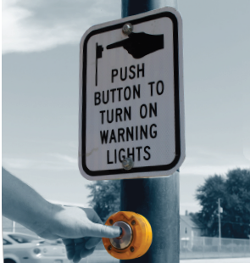
TAPCO BlinkerSign Installation

Slide 4
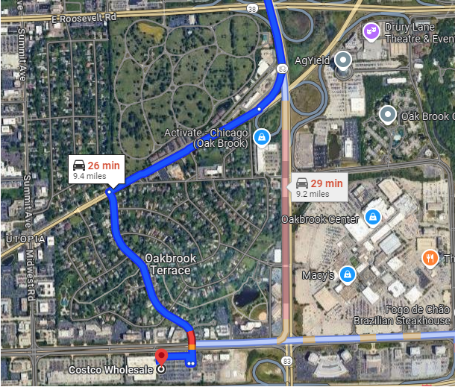
Google Route to Costco

Slide 5
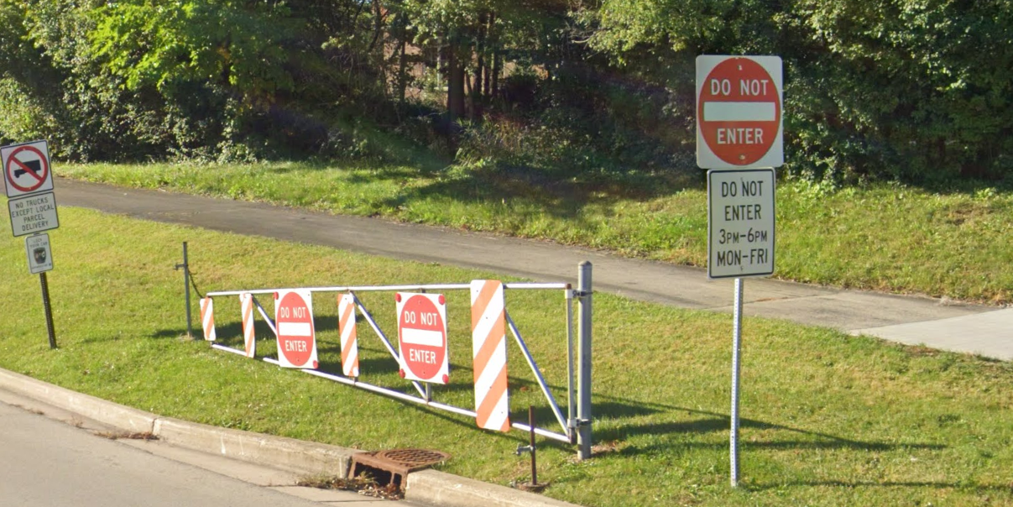
Oakbrook – 31st Street and Spring Road

